Slide 1
Hashing
CSS 343: Data Structures, Algorithms, and Discrete Mathematics II
Version 1
Wooyoung Kim

Slide 2
Hash Table
Average complexity
Insert/delete/retrieval of binary search trees?
Hash table: O(1)
Worst-case complexity
Insert/delete/retrieval of binary search trees?
Hash table: O(n)
Basic idea:
use a hash function to map the items into positions in an array
Problem: Collision, and clustering

Slide 3
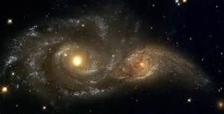
Collisions
Collision
When two keys map to the same location in the hash table
Flavors of Collision Resolution
Closed hashing (Open addressing technique)
Linear probing
Quadratic Probing
Double Hashing
Open hashing (Reconstructing the hash table with a linked lists)
Buckets
Separate chaining

Slide 4
Closed hashing
When a collision occurs, find another bucket for the new object
Probing distance function D(i) to resolve collisions
i: number of collisions in the current attempt
Next bucket to exam: ( h(x) + D(i) ) mod B
B: total # of buckets in a hash table
Generally suggested B: prime number and at least 2*expected # of items
D(i)
Linear probing: D(i) = i
Quadratic probing: D(i) = i²
Double hashing: D(i) = i*h₂(x)

Slide 5
Linear probing
After i collision, ( h(x) + D(i) ) mod B
( h(x) + D(i) ) mod B, where D(i) = i
That is, if A[i] is occupied
Try A[(i+1) mod N], if still occupied
Try A[(i+2) mod N],
And so on,
Assume h(x) = x%10, B = 10 (hash table size)
Example
37, 98, 107, 20, 57
Practice
Suffer from Primary Clustering Problem
"Long runs of occupied slots built up (near the h(x) positions), increasing the average search time."
0 | 20
1 | 57
2
3
4
5
6
7 | 37
8 | 98
9 | 107

Slide 6
Quadratic probing
After i collision, ( h(x) + D(i) ) mod B
( h(x) + D(i) ) mod B, where D(i) = i²
That is, if A[i] is occupied
Try A[i+1² mod N], if still occupied
Try A[i+2 ² mod N],
And so on,
Assume h(x) = x%10, B = 10 (hash table size)
Example: 37, 98, 107, 20, 57
Although fewer, suffer from Secondary Clustering
elements that hash to the same position will probe the same alternate cells (same sequence is followed to handle collision)
The size of the hash table should be a prime number to avoid repeats
0 | 20
1 | 107
2
3
4
5
6 | 57
7 | 37
8 | 98
9

Slide 7
Double hashing
( h(x) + D(i) ) mod B, where D(i) = i*h₂(x)
Typically, h₂(x) = r – (x % r); r is a prime number smaller than B
Example
37, 98, 107, 20, 57
Assume h(x) = x % 10; h₂(x) = 7 – (x % 7)
Hint:
Calculate h(x) and h₂(x).
Index = (h(x) + i* h₂(x))%10, where i=0,1,2,3,…
0 | 20
1
2 | 107
3 | 57
4
5
6
7 | 37
8 | 98
9
Notes:
107:
Index = (h(107) + i*h2(107))%10
H(107)=7, h2(107)=7-(107%7)=7-2=5
So, (7+i*5)%10
When i=0, occupied. So the next is 12%10=2
57:
H(57)=7, h2(57)=7-(57%7)=7-1=6
So, (7+i*6)%10
When i=0, occupied. So the next is 13%10=3

Slide 8
Double hashing (2)
Example
89, 18, 49, 58, 50, 60, 23
Index = ( h(x) + D(i) ) mod B, where B=10
h(x) = x % 10; h₂(x) = 7 – (x % 7); D(i) = i*h₂(x)
If B is non-prime number, possibly lead to cycle of repeated visits
0 | 50
1
2 | 60
3 | 58
4
5
6 | 49
7
8 | 18
9 | 89
Fail on 23
Notes:
49: h2(49)=7-0=7
Index = (9+i*7)%10 = 6 when i=1
58: h2(58) = 7-(58%7) = 7-2 = 5
Index = (8+i*5) %10 = 3
60: h2(60) = 7-(60%7) = 3
(0+i*3) = 3, 6, 9, 2
Index =2
23: h2(23) = 7-(23%7) = 7-2=5
(3+i*5) = 3, 8, 3, 8, ……

Slide 9
Open hashing
each bucket of the hash table stores a linked list of the objects that hash to that bucket
A simple example
h(x) = x % 10, hash 78, 38, 43, 248
Practice
0
1
2
3
4
5
6
7
8
9
43
78
38
248

Slide 10
Define hash function
Define your own hash function:
How to write a hash function to quickly find the following educational programs at UW Bothell in a hash table (BBUS, BEDUC, BES, BHLTH, BLS, BNURS, BPOLST, CSS)
Note: A good hash function is
1) Easy to compute
2) Will evenly distribute the possible data
Try:
1) Use a prime number as a size of hash table
2) Avoid collision

Slide 11
Define hash function
Define your own hash function:
How to write a hash function to quickly find the following educational programs at UW Bothell in a hash table (BBUS, BEDUC, BES, BHLTH, BLS, BNURS, BPOLST, CSS)
WAY #1:
sum up ascii values of each character and use table size 17
A -> 65
B -> 66
…
Z -> 90
CSS: C(67)+S(83)+S(83) => 233 %17 = 12
After finish it, you can shift the values so that the smallest number be zero

Slide 12
Define hash function
Define your own hash function:
How to write a hash function to quickly find the following educational programs at UW Bothell in a hash table (BBUS, BEDUC, BES, BHLTH, BLS, BNURS, BPOLST, CSS)
WAY #2:
2-D array with its length as the row
Total of 5 rows (index starts from 1)
The second letter, asci value % 5 (5 = column)
CSS
row=3, column = 83%5 = 3.
So, CSS is in array[3][3]

Slide 13
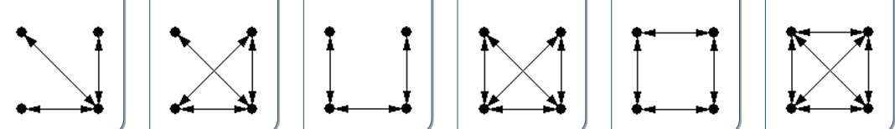
Graph hash function
How to define a hash function for a graph?
Design your own hash function to store all the 6 types of graphs.
Reference: g6 format see Files/additional materials/format.txt on Canvas

